Slide 1
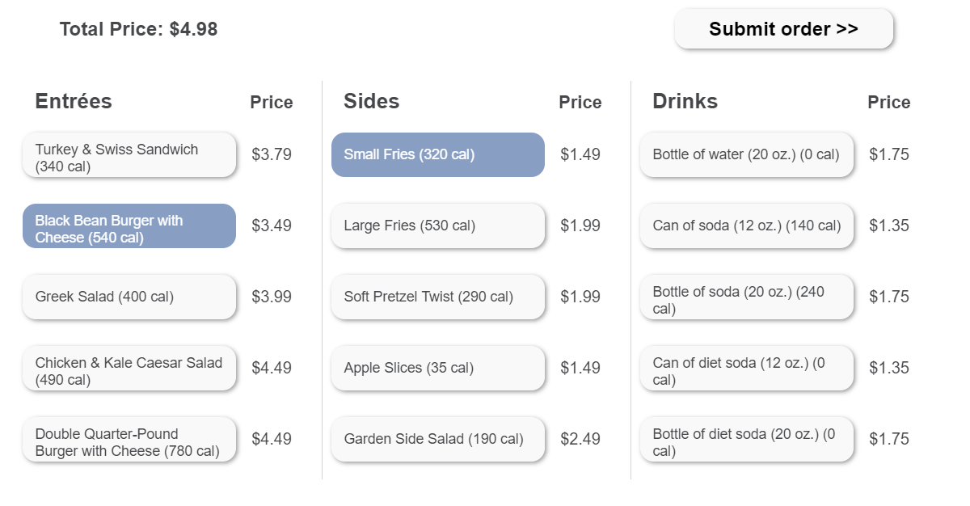
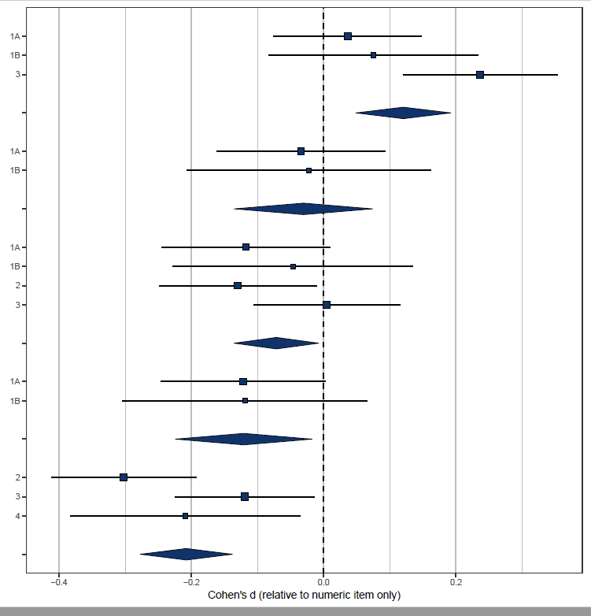
Choosing the Light Meal
Real-time Aggregation of Calorie Information Reduces Meal Calories
Eric M. VanEpps, Andras Molnar*, Julie S. Downs, & George Loewenstein
SUMMARY
METHODS (STUDY 2)
MECHANISM (STUDY 2)
Although numeric calorie labeling of individual items on restaurant menus has been implemented nationwide under an FDA mandate, prior research has generally not found significant effects of calorie labeling on calories ordered. Whereas past research testing calorie labeling has only applied the labels to individual items, the present research tests the impact of an innovation that can easily be implemented in online ordering: dynamic aggregation of calorie content to provide dynamic feedback about total calories in a meal.
Across four preregistered online studies and a field study (total N = 9048) we show that real-time, dynamic feedback about the total calorie content of meals guides consumers to order both fewer items and lower-calorie items, even when static guidelines and item-level calorie labels are already present. The reduction of calories is particularly strong when feedback is presented as dynamically updating traffic lights, prompting consumers to revise their orders more frequently. This type of dynamic aggregation with traffic lights is significantly more effective in reducing calories than any other type of calorie labeling, featuring item labels, dynamic numeric aggregation, or text guidance with calorie recommendations.
The results also suggest that aggregation requires dynamic presentation to achieve calorie reductions, because this type of feedback uniquely drives consumers to take actions: to reconsider their selections and choose lower-calorie alternatives. We propose that this revision process represents a decision-making step that is unlikely in the absence of dynamic aggregated labels (i.e., static labels only), and that real-time feedback before purchase represents a novel intervention to guide consumer choice.
Σ
Considered
750+ (no/yes)
Actions per item
No
aggregation
Numeric aggregation
Traffic light aggregation
.004 / .437***
−.146***
Traffic light aggregation
−.172** / .044
Meal calories
−.050
Number of items
.193***
Moderated mediation analysis
(baseline: numeric aggregation)
ROBUSTNESS & META-ANALYSIS
Results are robust to:
Demographic characteristics (age, gender, income)
Different subject pools (Study 1A vs. Study 1B)
Presence / absence of normative numeric guideline (Study 3)
Hypothetical vs. real choice (Study 4)
RESULTS (STUDY 2)
400 cal
300 cal
200 cal
OVERVIEW OF STUDIES
Total calories ordered
Items ordered
Reference: numeric item labels only
STUDY | CHOICE TYPE | SUBJECT POOL | TOTAL SAMPLE | CONDITIONS
 |  |  |  | No label | Traffic light item | Traffic light item + Traffic light meal | Numeric item | Numeric item + Numeric meal | Numeric item + Traffic light meal
1A | Hypothetical | MTurk | 2820 | ● | ● | ● | ● | ●
1B | Hypothetical | University alumni | 1372 | ● | ● | ● | ● | ●
2 | Hypothetical | MTurk | 1823 |  |  |  | ● | ● | ●
3 | Hypothetical | MTurk | 2524 | ● |  |  | * | * | *
4 | Real | University participants | 509 |  |  |  | ● |  | ●
* Note: these conditions also featured a static numeric guideline on the screen
No labels
Traffic light item only
400 cal
300 cal
200 cal
+ Σ900
Average calories per item
Actions per item
Numeric item +
numeric aggregation
+ Σ
Traffic light item +
traffic light aggregation
400 cal
300 cal
200 cal
+ Σ
Numeric item +
traffic light aggregation
Cohen’s d (relative to numeric item only)

